Slide 1
Deep Learning: CNNs

Slide 2
Last time
We trained our first deep learning models
To classify images
We talked about some of the other applications of deep learning models
Such as natural language processing

Slide 3
In this lecture we will:
Introduce Convolutional NNs for computer vision
Discuss ImageNet
Understand transfer learning
Understand practical tips for developing deep learning models

Slide 4
We’ve now classified images multiple ways
With scikit-learn’s MLP
With PyTorch’s MLP via GPU and tensors
But can we improve upon these models?

Slide 5
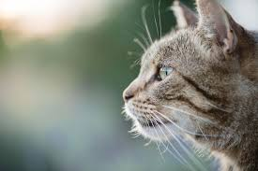
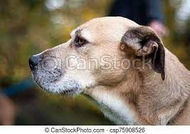
Convolutional NNs: back to the human brain
How does your brain distinguish between a cat and a dog?
The human visual cortex begins with the cells in your retina, and (arguably) ends with a conscious decision about what the object is that you’re looking at
The retina contains three cone cells for color perception in the center of your vision (red, green, and blue), but let’s imagine we’re colorblind, and can only see in black and white
Each cone will fire when a certain amount of light enters the retina
The retinal neurons’ activations are then collected, and processed into ever-increasingly-complex shapes?
A subset of neurons that all fire together identify a curve
Your brain recognizes when it has adjacent curves that are in the shape of an ear
Different body parts are assembled, and in the end a decision is made as to the type of animal we’re looking at

Slide 6
How does your brain know to ignore irrelevant parts of the image?
Imagine trying to classify a lion versus a tiger
A photo of a tiger in the snow may have more “different” pixels than a photo of the same tiger in a jungle
Compared to a lion versus a tiger on the same black background
How do our brains know to focus on just the important parts of the animal, and not the background?
How have our brains learned that the position of the animal isn’t important?

Slide 7
CNNs: mimic human vision?
Input layer of pixels (like the activation from cones in the retina)
Hidden layers that looks at patches of adjacent cells/nodes in a lower layer to learn a higher-order feature
A lower-level patch of 5x5 or 10x10 pixels has a curve on it, or doesn’t
Subsequent layers assemble the higher-order features (a curve) into even higher-order ones
Output layer that classifies the image
CNNs use layers that are different from fully-connected layers we have seen so far
Convolutional layer: applies a filter to a patch of pixels
Pooling layer: simplifies the values in a patch to a single value

Slide 8
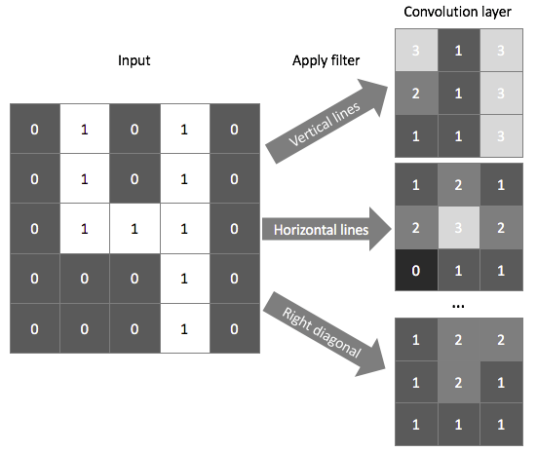
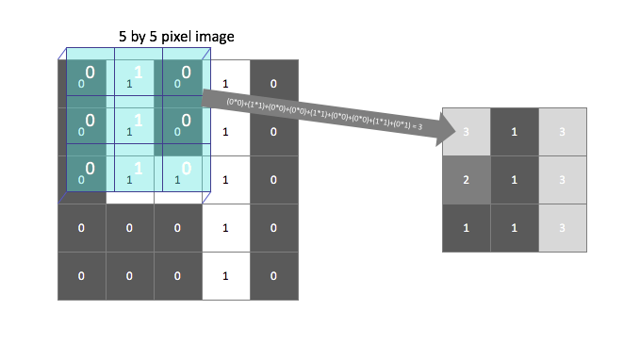
Layers of a CNN: Convolutional layer
Images from https://www.jeremyjordan.me/convolutional-neural-networks/
Convolutional layer: applies a filter/kernel to a patch of pixels [or node activations], and sums the results on the patch
The filter/kernel could be used to see if that patch of pixels has a line or not
Output of a convolution is referred to as a feature map
The model learns these filters during training
Convolution stands for the “folding” or “coiling” that a feature map performs on its inputs

Slide 9
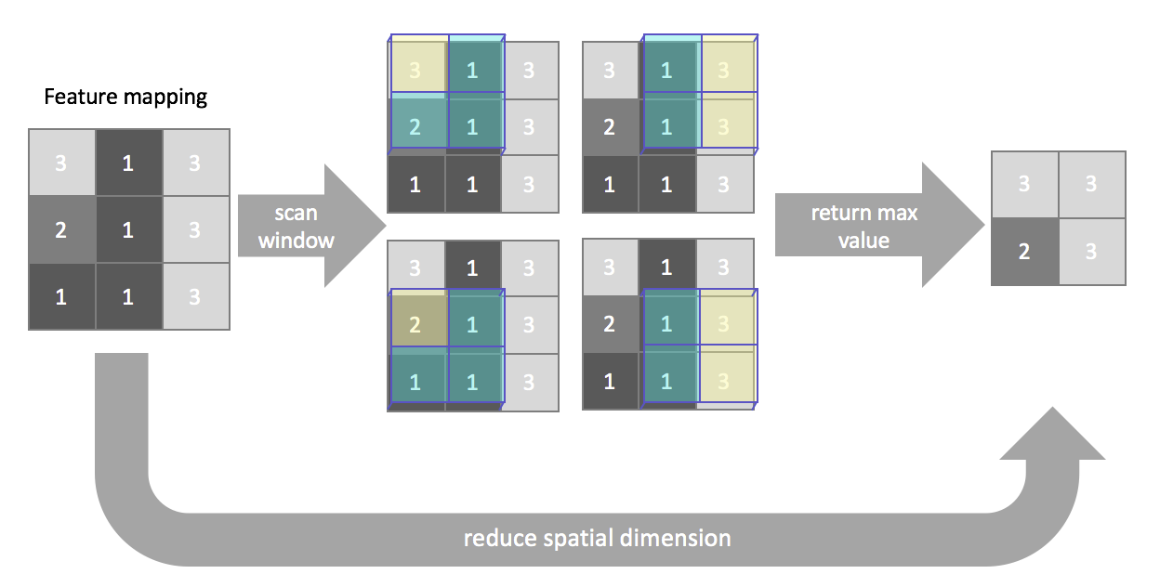
Layers of a CNN: Pooling layer
Image from https://www.jeremyjordan.me/convolutional-neural-networks/
Pooling layer: sums/averages/takes-max values of a patch
Allows us to do something like “count” the number of lines in an area
Pooling layer representation is meant to vary little when elements in previous layer vary in position
Typically follows a convolutional layer
Example of the original image “simplified” when looking for vertical lines
Each box here is for a patch of the image below

Slide 10
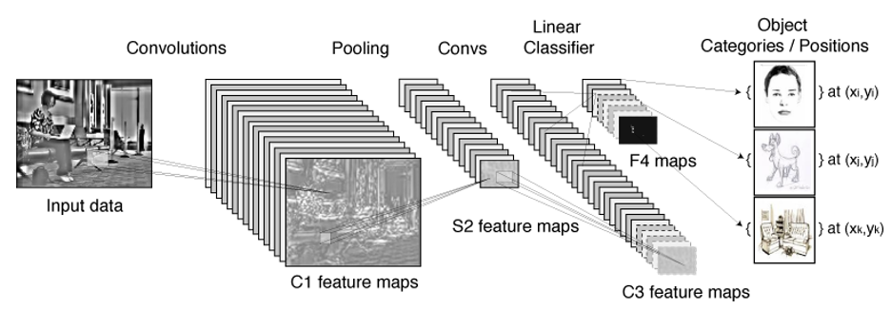

Overall network
Images from https://towardsdatascience.com/a-comprehensive-guide-to-convolutional-neural-networks-the-eli5-way-3bd2b1164a53, https://www.mobiquity.com/insights/introduction-to-convolutional-neural-networks
Convolutional layers refine patches into lines/shapes via filtering into feature maps

Slide 11
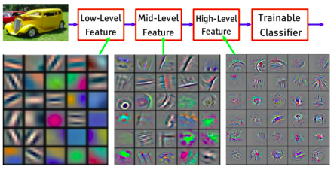
Filtering via convolutional and pooling layers
Lower filters identify more basic shapes, which are the assembled into more complex shapes in higher layers/filters
Conv2DLayer -> ReLU -> PoolingLayer idiom commonly seen
Image from https://wiki.tum.de/display/lfdv/Convolutional+Neural+Networks

Slide 12
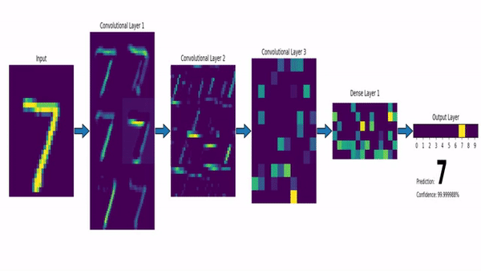
CNNs: classification layers
Standard, fully-connected layers are used to classify the features for a final answer
Fully connected layers
MNIST image from: https://www.mobiquity.com/insights/introduction-to-convolutional-neural-networks

Slide 13
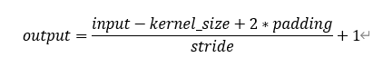
Example of a CNN definition in PyTorch
See https://github.com/IQTLabs/BioNIC/blob/master/models.py line 568
kernel_size is the size of the patch (i.e. 7x7)
stride is how many “pixels” to move when going to the next patch
padding, in “pixels,” is often used to be able to meaningfully apply a filter on a patch that is at the edge of the image
This model is adding batch normalization after the ReLU activation
Creates ten filters (feature maps) on the input layer
Then another twenty filters (feature maps) after pooling
If input images are 224x224 RGB, why are there 54,080 nodes on line 589?
Let’s take 10 minutes in class to trace through (do it on your own later)

Slide 14
CNNs: dealing with images: PyTorch transforms
Your images will typically be 1 channel (greyscale) or 3 channel (color)
Loading images often involves transforming them pre-training:
Need to convert an image to a tensor in PyTorch: transforms.ToTensor( )
When converting an image into such a tensor, PyTorch will convert the pixel value (between 0 and 255) into a value between 0 and 1
We often also want to normalize the images’ pixel values to help the models learn
transforms.Normalize(mean, stddev) expects two lists with a mean and stddev for each channel
Normalization will set the mean to 0, setdev to 1
Why is a mean of 0 desirable?
Option 1: use a “standard” mean/stddev like one from ImageNet: mean=[0.485, 0.456, 0.406],
std=[0.229, 0.224, 0.225]
Option 2: Calculate the average mean and stddev value for your specific dataset manually, and pass these into transforms.Normalize( )

Slide 15
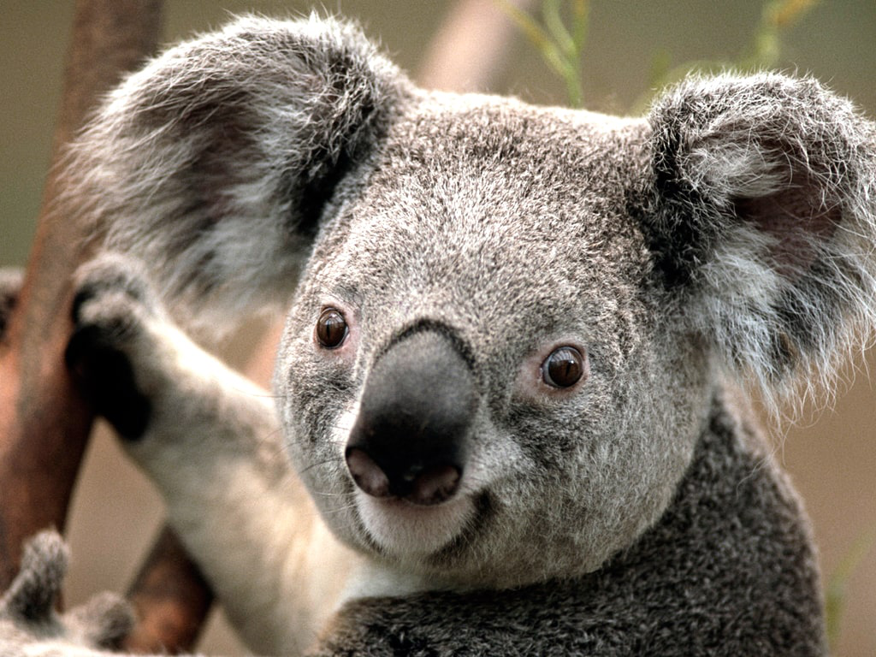
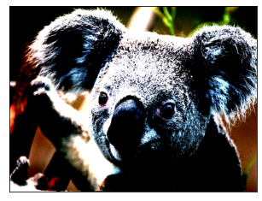
Normal vs normalized image example
Images from https://www.geeksforgeeks.org/how-to-normalize-images-in-pytorch/

Slide 16
More advanced dataset augmentation
You may need to scale your images into smaller sizes to use CNNs successfully
224x224 is common, also used for ImageNet
It’s also common practice to perform dataset augmentation during training for better generalization/performance
Here we flip, rotate, color jitter, and transforms images in ways that shouldn’t matter for our classification goal
Beyond that? Depends on your particular use case
Shouldn’t change the “meaning” of the image – should always be adding “noise”
Some examples for facial recognition: https://manmeet3.medium.com/face-data-augmentation-techniques-ace9e8ddb030
Some examples for biological cells – thresholding: https://www.iqt.org/an-ai-based-application-using-organ-on-a-chip-data/
What others can you think of?

Slide 17
In-class exercise in groups of 2-3 students [3 min]
Complete the following example to understand how to prepare an image dataset for training with CNNs;
Decide which of these transforms can be applied to the FashionMNIST dataset; comment out ones that don’t make sense for our dataset
When applying transforms/ augmentations to your own images, you’ll use the transforms in a DataLoader:
train_transforms = [
transforms.RandomRotation(degrees=90),
transforms.ColorJitter(),
transforms.RandomHorizontalFlip(),
transforms.RandomVerticalFlip(),
transforms.Resize(size=[224,224]),
transforms.ToTensor(),
transforms.Normalize([0.1306],[0.3081])
]
relevant for BN
images = datasets.ImageFolder(root=path_to_folder, transform=transforms.Compose(train_transforms))
data_loader = torch.utils.data.DataLoader(images, batch_size=32, shuffle=True, drop_last=False)

Slide 18
Building your own computer vision models
You know now all the pieces to build your own CNN models to do image classification
Training these models can be very data-intensive: want 1000s of images
What if you have far fewer, just a couple hundred or less?
Solution: Transfer learning
Take a deep learning model that has already been trained to classify a large set of images by someone else (so it has useful weights)
Use that model architecture, and its weights, as the start of your own training: you are transferring the learning from this model in this pre-train step
Fine-tune that pre-trained model using your own, smaller dataset
For computer vision classification tasks, we frequently grab a model pre-trained on ImageNet
Allows you to quickly train a model with just a relatively small number of images

Slide 19

Models pre-trained on ImageNet for transfer learning
See https://pytorch.org/vision/stable/models.html for a list
ImageNet is a database of common, everyday objects
14M hand-annotated images of about 20K categories
Idea is that your image classification tasks will share the same low-level features as an ImageNet classification task, so you can just start with the weights trained on the latter

Slide 20
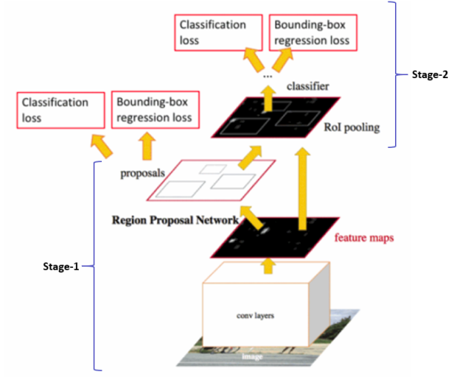
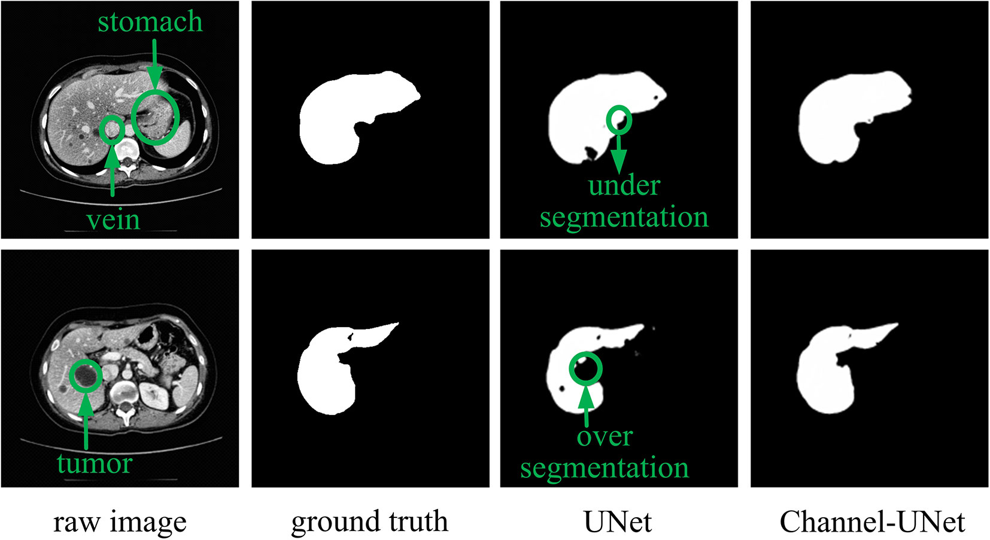
What else can we do with computer vision?
Images from https://developers.arcgis.com/python/guide/how-maskrcnn-works/, https://www.frontiersin.org/articles/10.3389/fgene.2019.01110/full
Segmentation of images
Where are the cars in this image? Draw boxes around them.
How many cells are there in this image? Draw boxes around them.
Where is the tumor in this image? Outline its borders carefully.
Example models: Mask-RCNN, U-Net
To get you started: https://github.com/matterport/Mask_RCNN
Mask-RCNN

Slide 21
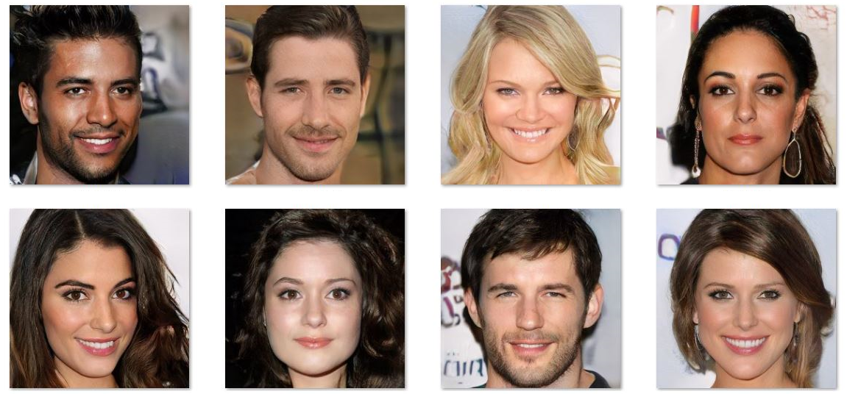
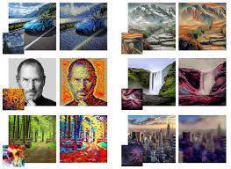
What else can we do with computer vision?
Guest lecture by Dr. Zig Hampel-Arias later this semester (?)
Generative Advesarial Networks (GAN)s can be used to generate convincing synthetic (fake) images, as well as transfer style between images
Images from https://towardsdatascience.com/light-on-math-machine-learning-intuitive-guide-to-neural-style-transfer-ef88e46697ee, https://medium.datadriveninvestor.com/artificial-intelligence-gans-can-create-fake-celebrity-faces-44fe80d419f7

Slide 22
Further reading
https://www.nature.com/articles/nature14539.pdf

Slide 23
Homework 7: In-class exercise in groups of 2-3 students [rest of class]
Let’s grab the malaria blood cell dataset from: https://lhncbc.nlm.nih.gov/LHC-downloads/downloads.html at ftp://lhcftp.nlm.nih.gov/Open-Access-Datasets/Malaria/cell_images.zip
Use the command line wget to download the file from the ftp server
Two classes: infected and uninfected
Work in teams to:
Pre-process images into train, validation, and holdout by randomly specifying indicies and feeding these to torch.utils.data.sampler.SubsetRandomSampler
Add applicable data augmentations to your DataLoader
Choose and download a CNN pre-trained on ImageNet
Fine-tune that CNN on your blood cell images using training and validation
Report your results on the test set

Slide 24
Next up: Guest lecture by Joe Goldfrank!
State machines, HMMs, and reinforcement learning
Machine learning models meant for learning sequential patterns
There is a time component to the data, unlike our NNs and other models
Joe Goldfrank is a PhD candidate in Stanford's Management Science & Engineering program, studying risks involved in operation of networked autonomous systems. Before graduate school, he worked at the DoD Strategic Capabilities Office, on Wall Street, and served on active duty in the US Navy.

